Slide 1

{Presents}
.

Slide 2

TEAM 49:
Sandisiwe Mahanjana s225918889
Simthandile Njenkele 223129380
Batsiba Mawelele 225997096
Lehlohonolo Molakeng 224537458

Slide 3
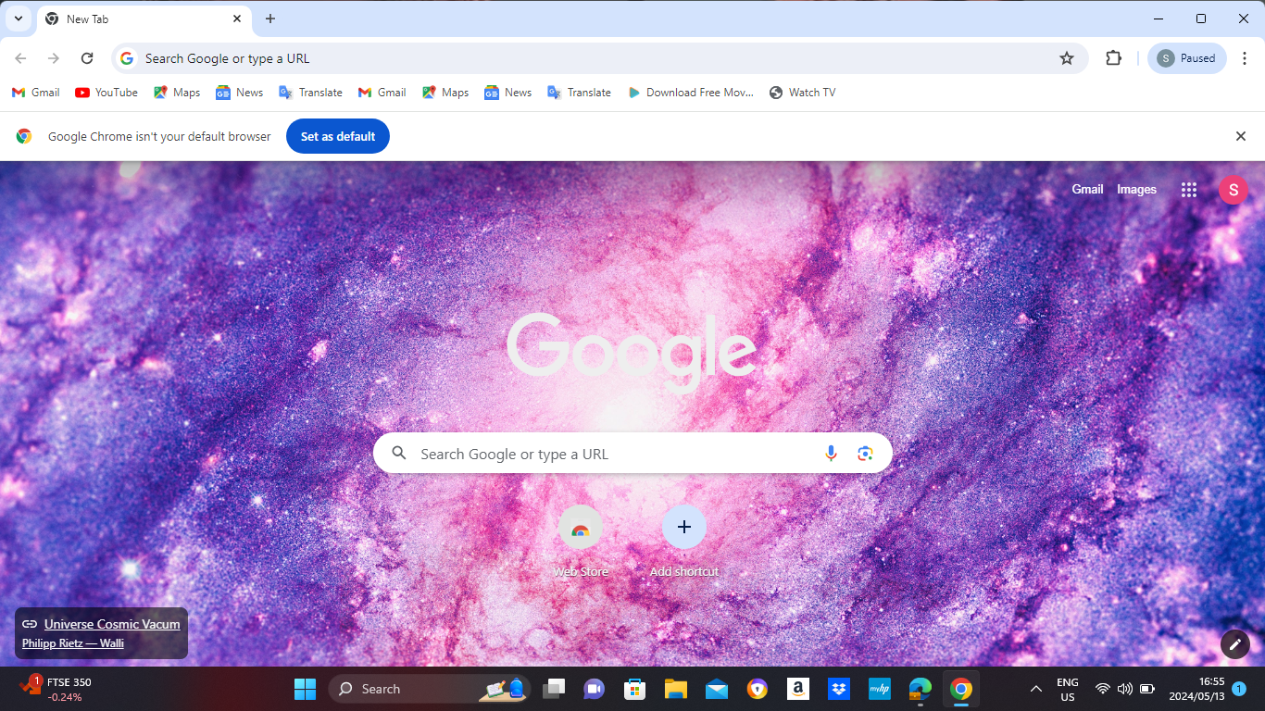

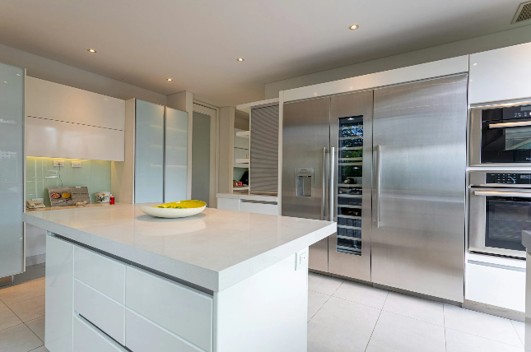
Home
About
Contact
Login
Keep it cool, get yours today
Clicking the home button will take back to this page.
Click to learn more about what our business do.
Click to view our contact details.
Fridge for you
Keep it cool, Get yours today.

Slide 4



Home
About
Contact
Login
Keep it cool, get yours today
Contact Us
All are required.
Nort End
Port Elizabeth
6001
Name
Email
info@fridge4you.co.za
Address
041 632 0000
Contact Number
How can we help you?
Send
2024 fridge4you Cookie Policy Privacy Policy Careers Promotions

Slide 5
Home
About
Contact
Login
Keep it cool, get yours today
About Us
The aim of Fridge4 you is that we want to make sure all our customer receives the best and high-quality operating fridges.
2024 fridge4you Cookie Policy Privacy Policy Careers Promotions

Slide 6



Home
About
Contact
Login
Keep it cool, get yours today
WELCOME BACK
Username
Nice to see you again
Password
Login
Forgot password?
2024 fridge4you Cookie Policy Privacy Policy Careers Promotions

Slide 7

Home
About
Contact
Login
Keep it cool, get yours today
Create New Password
Enter new password
*****
GHTTY
Show
Hide
Confirm new password
Reset
2024 fridge4you Cookie Policy Privacy Policy Careers Promotions

Slide 8
Home
About
Contact
Login
Keep it cool, get yours today
Create New Password
Enter new password
German#2
Hide
********
Show
GHTTY
Confirm new password
********
Hide
Show
German#2
Password must contain at least 8 characters long include at least 1 uppercase, 1 lowercase, 1 numbers and 1 special characters.
Reset
Your password is reset.
2024 fridge4you Cookie Policy Privacy Policy Careers Promotions

Slide 9
Home
About
Contact
Login
Keep it cool, get yours today
WELCOME BACK
Username
Admin
Nice to see you again
Password
Login
Forgot password?
2024 fridge4you Cookie Policy Privacy Policy Careers Promotions

Slide 10
Home
About
Contact
Login
Keep it cool, get yours today
WELCOME BACK
Admin@gmail.com
Nice to see you again
German#2
********
Show
Hide
Password
Invalid email or password!!
Login
Forgot password?
2024 fridge4you Cookie Policy Privacy Policy Careers Promotions

Slide 11
Administrator:
Manage Customers
Manage Employees
Manage Fridges
Manage Locations
Manage Business Info
Manages Suppliers

Slide 12







Selena Gomez
Admin
Keep it cool, get yours today
Welcome
Dashboard
Customers
Employees
Fridges
Suppliers
Locations
Business info
Logout

Slide 13


Search
Selena Gomez
Admin
Keep it cool, get yours today
Dashboard
Back
2024 fridge4you Cookie Policy Privacy Policy Careers Promotions

Slide 14
Selena Gomez
Admin
Keep it cool, get yours today
Welcome
Dashboard
Customers
Employees
Fridges
Suppliers
Locations
Business info
Logout

Slide 15

Search
Selena Gomez
Admin
Keep it cool, get yours today
Customers
PDF
Export
Search
Name | Surname | Email | Contact | Address | Status
Sandisiwe | Mahanjana | mahanjanasandisiwe649@gmail.com | 0817933336 | 14 Honeybird 37 Perkins street Nort End | Active
Mbalentle | Leleki | lelekimbalentle@gmail.com | 0611821314 | 13 Havelock Street Central | Inactive
Kim | Kardashian | kimk81@gmail.com | 0780890603 | 21 Chapel Street Central | Active
Back
2024 fridge4you Cookie Policy Privacy Policy Careers Promotions

Slide 16
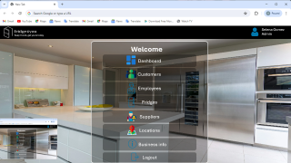
Selena Gomez
Admin
Keep it cool, get yours today
Welcome
Dashboard
Customers
Employees
Fridges
Suppliers
Locations
Business info
Logout

Slide 17
Search
Selena Gomez
Admin
Keep it cool, get yours today
Employees
Add Employee
Search
PDF
Export
Name | Contact | Email | Type | Status | Action
Abraham | 081 793 3336 | Abraham56@gmai.com | Maintenance Technician | Active | Edit/Remove
Selena Gomez | 0834945804 | gomezselena@gmail.com | Administrator | Active | Edit/Remove
Back
2024 fridge4you Cookie Policy Privacy Policy Careers Promotions

Slide 18
Search
Selena Gomez
Admin
Keep it cool, get yours today
New employee
First Name:
Last Name:
Hova
Email:
IshmaelHova85@gmail.com
Employee Type:
Maintenance Technician
Maintenance Technician
Employee Status:
Fault Technician
Active
Active
Inactive
Back
Add
2024 fridge4you Cookie Policy Privacy Policy Careers Promotions

Slide 19
Search
Selena Gomez
Admin
Keep it cool, get yours today
New employee
First Name:
Ishmael
* This field is required!
Last Name:
Hova
Email:
IshmaelHova85@gmail.com
Employee Type:
Fault Technician
Employee Status:
Active
Back
Added Successfully.
Add
2024 fridge4you Cookie Policy Privacy Policy Careers Promotions

Slide 20
Search
Selena Gomez
Admin
Keep it cool, get yours today
Employees
Add Employee
Search
PDF
Export
Name | Contact | Email | Type | Status | Action
Abraham | 081 793 3336 | Abraham56@gmail.com | Maintenance Technician | Active | Edit/Remove
Ishmael Hova | 078 789 5667 | IshmaelHova84@gmail.com | Fault Technician | Active | Edit/Remove
Back
2024 fridge4you Cookie Policy Privacy Policy Careers Promotions

Slide 21
Selena Gomez
Admin
Keep it cool, get yours today
Welcome
Dashboard
Customers
Employees
Fridges
Suppliers
Locations
Business info
Logout

Slide 22
Search
Selena Gomez
Admin
Keep it cool, get yours today
FRIDGES
Click to update or remove fridge.
Add New Fridge
Search
PDF
Export
Fridge Name | Fridge Type | Model No | Features | Status | Action
Samsung | French door refrigerator | WRF767SDHZ | Platter pocket Fingerprint Resistant In-door-Ice | Available
Hisense | side-by-side refrigerator | WRS571CIHV | Can Caddy Deli Drawer | Available | Edit/Remove
Edit/Remove
Back
2024 fridge4you Cookie Policy Privacy Policy Careers Promotions

Slide 23
Search
Selena Gomez
Admin
Keep it cool, get yours today
Edit Fridge
Fridge Name:
Samsung
Fridge Type:
French door refrigerator
Model:
XRF767SDHZ
Features:
In-door-ice
Status:
Available
Out-of-Stock
Back
Add
Remove
2024 fridge4you Cookie Policy Privacy Policy Careers Promotions

Slide 24
Search
Selena Gomez
Admin
Keep it cool, get yours today
Edit Fridge
Fridge Name:
Samsung
Fridge Type:
French door refrigerator
Model:
XRF767SDHZ
Features:
In-door-ice
Status:
Out-of-Stock
Back
Add
Remove
Added successfully.
2024 fridge4you Cookie Policy Privacy Policy Careers Promotions

Slide 25
Selena Gomez
Admin
Keep it cool, get yours today
Welcome
Dashboard
Customers
Employees
Fridges
Suppliers
Locations
Business info
Logout

Slide 26
Search
Selena Gomez
Admin
Keep it cool, get yours today
Suppliers
Add New Supplier
Search
PDF
Export
Name | Email | Contact | Join Date | Status | Action
Samsung | zaservice@samsung.com | 086 049 1600 | 21/01/2024 | Paid | Edit/Remove
Hisense | b2service@hisense.co.za | 060 436 0888 | 16/04/2024 | Pending | Edit/Remove
Back
2024 fridge4you Cookie Policy Privacy Policy Careers Promotions

Slide 27
Selena Gomez
Admin
Keep it cool, get yours today
Welcome
Customers
Employees
Fridges
Suppliers
Locations
Business info
Logout

Slide 28
Subsystem A:
Customer Service
Manage Customers
Create Fridge Allocation

Slide 29



Anele Nzolo
Customer Service
Keep it cool, get yours today
Welcome
Customers
Fridges
Logout
2024 fridge4you Cookie Policy Privacy Policy Careers Promotions

Slide 30
Search
Anele Nzolo
Customer Service
Keep it cool, get yours today
Customers
Add Customer
Search
PDF
Export
Name | Surname | Email | Address | Contact | Status | Action
Mbalentle | Leleki | lelekimbalentle@gmail.com | 13 Havelock Street Central | 0611821314 | Inactive
Edit/Remove
Back
2024 fridge4you Cookie Policy Privacy Policy Careers Promotions

Slide 31
Search
Anele Nzolo
Customer Service
Keep it cool, get yours today
New Customer
Name:
Sandisiwe
Surname:
Mahanjana
Email:
Mahanjanasandisiwe649@gmail.ccom
Contact:
081 793 3336
Address:
14 Honeybird 37 Perkins street North End
Status:
Active
Add
Inactive
2024 fridge4you Cookie Policy Privacy Policy Careers Promotions

Slide 32
Search
Anele Nzolo
Customer Service
Keep it cool, get yours today
New Customer
Name:
Sandisiwe
Surname:
Mahanjana
Email:
Mahanjanasandisiwe649@gmail.ccom
Contact:
081 793 3336
Address:
14 Honeybird 37 Perkins street North End
Status:
Active
Added Successfully.
Add
2024 fridge4you Cookie Policy Privacy Policy Careers Promotions

Slide 33
Search
Anela Nzolo
Customer Service
Keep it cool, get yours today
Customers
Add Customer
Search
PDF
Export
Name | Surname | Email | Address | Contact | Status | Action
Mbalentle | Leleki | lelekimbalentle@gmail.com | 13 Havelock Street Central | 0611821314 | Inactive
Sandisiwe | Mahanjana | mahanjanasandisiwe649@gmail.com | 21 Chapel Street Central | 0780890603 | Active
Edit/Remove
Edit/Remove
Back
2024 fridge4you Cookie Policy Privacy Policy Careers Promotions

Slide 34
Anele Nzolo
Customer Service
Keep it cool, get yours today
Welcome
Customers
Fridges Allocation
Logout
2024 fridge4you Cookie Policy Privacy Policy Careers Promotions

Slide 35
Search
Anele Nzolo
Customer Service
Keep it cool, get yours today
Fridge Allocation
Click to make any changes.
Create Allocation
Search
PDF
Export
Customer | Address | Fridge Name | Allocation Date | Allocation Status | Action
Sandisiwe Mahanjana | 14 Honeybird 37 Perkins street North End | Samsung 36-inch wild French refrigerator | 03/01/2024 | Allocated
Mbalentle Leleki | 21 Chapel Street Central | Hisense 36-inch wild counter depth side-by-side refrigerator | 05/02/2024 | Allocated
Edit/Remove
Edit/Remove
Back
2024 fridge4you Cookie Policy Privacy Policy Careers Promotions

Slide 36
Anele Nzolo
Customer Service
Keep it cool, get yours today
Welcome
Customers
Fridges Allocation
Logout
2024 fridge4you Cookie Policy Privacy Policy Careers Promotions

Slide 37
Subsystem A:
Stock Manager
Receive New Fridges
Scrap Fridges
Process Customer Fridge Allocation
Create purchase request

Slide 38
Iyo Sky
Stock Manager
Keep it cool, get yours today
Welcome
Fridges
Purchase
Logout
2024 fridge4you Cookie Policy Privacy Policy Careers Promotions

Slide 39
Search
Iyo Sky
Stock Manager
Keep it cool, get yours today
Fridges
Click this button to view new fridges
Click this button to view scrap fridges
VIEW NEW FRIDGE
VIEW SCRAP FRIDGE

Slide 40
Search
Iyo Sky
Stock Manager
Keep it cool, get yours today
New Fridge
Search
PDF
Export
Fridge Name | Fridge Type | Model No | Features | Status
Samsung | French door refrigerator | WRF767SDHZ | Platter pocket Fingerprint Resistant In-door-Ice | Available
Back
2024 fridge4you Cookie Policy Privacy Policy Careers Promotions

Slide 41
Iyo Sky
Stock Manager
Keep it cool, get yours today
Welcome
Fridges
Purchase
Logout
2024 fridge4you Cookie Policy Privacy Policy Careers Promotions

Slide 42
Search
Iyo Sky
Sock Manager
Keep it cool, get yours today
Purchasing Manager
Samsung WRF767SDHZ and Hisence WRS571CIHV are about to finish. Do you want to order them?
By pressing the button, the purchasing manager, orders 20 fridges, as automatically made his system
By pressing the button, the purchasing manager does not order the fridges
YES
NO
2024 fridge4you Cookie Policy Privacy Policy Careers Promotions

Slide 43
Anele Nzolo
Customer Service
Keep it cool, get yours today
Welcome
Fridges
Purchase
Logout
2024 fridge4you Cookie Policy Privacy Policy Careers Promotions

Slide 44
Subsystem B:
Fault Management
Customer
Create Fault
View fault status
Create fridge request
View request status

Slide 45




Kim k
Customer
Keep it cool, get yours today
Welcome
View Faults
When clicked, you will be taken to the Faults Page
Request Fridge
Appointments
Services
Logout
2024 fridge4you Cookie Policy Privacy Policy Careers Promotions

Slide 46
Kim k
Customer
Keep it cool, get yours today
One of our Fridges is giving you problems?
Create Fault Report
Once clicked, you will be taken to the fault report form page
Want to check on your fault Report?
View Fault Status
2024 fridge4you Cookie Policy Privacy Policy Careers Promotions

Slide 47
Search
Kim K
Customer
Keep it cool, get yours today
Fridge Fault - Form
Complete this form and submit.
Name:
Contact:
Kim Kardashian
081 793 3336
Email:
Reported Date:
kimkardashian@gmail.com
05 May 2024
Fault Description:
My fridge has water dispenser
You submitted.
submit
CANCEL
@Fridge 4you 2024
2024 fridge4you Cookie Policy Privacy Policy Careers Promotions

Slide 48
Kim k
Customer
Keep it cool, get yours today
One of our Fridges is giving you problems?
Create Fault Report
Want to check on your fault Report?
View Fault Status
Once clicked, you will be taken to the fault status page
2024 fridge4you Cookie Policy Privacy Policy Careers Promotions

Slide 49
Search
Selena Gomez
Admin
Keep it cool, get yours today
Fault Status
View your fault status below.
Fault No | Report Date | Fridge Name | Fault Description | Assigned to | Status
245 | 05/05/2024 | Samsung 36-inch wild French refrigerator | Everything in the refrigerator is freezing even if I adjust the temperature settings. | Ishmael Hova | In Progress
Back
2024 fridge4you Cookie Policy Privacy Policy Careers Promotions

Slide 50
Kim k
Customer
Keep it cool, get yours today
Welcome
View Faults
Request Fridge
When clicked, you will be taken to the Fridge Request Page
Appointments
Services
Logout
2024 fridge4you Cookie Policy Privacy Policy Careers Promotions

Slide 51
Kim k
Customer
Keep it cool, get yours today
Want to replace your current rental fridge?
Request a new Fridge
Once clicked, you will be taken to the fridge request form page
Want to check on your fridge request status?
View Request Status
2024 fridge4you Cookie Policy Privacy Policy Careers Promotions

Slide 52
Search
Kim k
Customer
Keep it cool, get yours today
Fridge Request Form
Please use the form below to order fridge. All fields are required.
Name:
Email:
Simthandile Njenkele
simthandilenjenkele02@gmail.com
Reasons for Request:
Fridge specification:
Everything in the refrigerator is freezing even if I adjust the temperature settings.
Samsung 36-inch wild French door refrigerator
Budget:
Contact Number:
R 7000.00
076 567 3438
Form Submitted.
Submit
2024 fridge4you Cookie Policy Privacy Policy Careers Promotions

Slide 53
Kim k
Customer
Keep it cool, get yours today
Want to replace your current rental fridge?
Request a new Fridge
Want to check on your fridge request status?
View Request Status
Once clicked, you will be taken to the fridge request form page
2024 fridge4you Cookie Policy Privacy Policy Careers Promotions

Slide 54
Search
Kim k
Customer
Keep it cool, get yours today
Check Request Status
Request information. Find order Email.
Email:
simthandilenjenkele02@gmail.com
Continue
2024 fridge4you Cookie Policy Privacy Policy Careers Promotions

Slide 55
Search
Kim k
Customer
Keep it cool, get yours today
Request Status
Here you can view your status.
Date: 05 May 2024 20:06:06
Request status: Submitted
View
Click to view more.
Back
2024 fridge4you Cookie Policy Privacy Policy Careers Promotions

Slide 56
Kim k
Customer
Keep it cool, get yours today
Welcome
Faults
Request Fridge
Appointments
Once clicked, you will be taken to your calendar page
Services
Logout
2024 fridge4you Cookie Policy Privacy Policy Careers Promotions

Slide 57

Search
Kim k
Customer
Keep it cool, get yours today
Calendar
August 2024
Mon | Tue | Wed | Thu | Fri | Sut
 |  |  | 1 | 2 | 3
5 | 6 | 7 | 8 | 9 | 10
12 | 13 | 14 | 15 | 16 | 17
19 | 20 | 21 | 22 | 23 | 24
11:00 am
Fridge Maintenance
Back
2024 fridge4you Cookie Policy Privacy Policy Careers Promotions

Slide 58
Kim k
Customer
Keep it cool, get yours today
Welcome
Faults
Request Fridge
Appointments
Once clicked, you will be taken to your calendar page
Services
Logout
2024 fridge4you Cookie Policy Privacy Policy Careers Promotions

Slide 59
Search
Ishmael Hova
Fault Technician
Keep it cool, get yours today
Faults
Fault Number : 245
FRIDGE NAME:
Samsung 36-inch wild French refrigerator
FAULT DESCRIPTION:
Water dispenser
ACTION TAKEN:
Inspect the water supply line and connectors for leaks
REPORTED BY: | DATE:
Kim Kardashian | 05 May 2024
REPORTED TO: | DATE:
Abraham | 05 May 2024
2024 fridge4you Cookie Policy Privacy Policy Careers Promotions

Slide 60
Kim k
Customer
Keep it cool, get yours today
Welcome
Faults
Request Fridge
Appointments
Once clicked, you will be taken to your calendar page
Services
Logout
2024 fridge4you Cookie Policy Privacy Policy Careers Promotions

Slide 61
Subsystem B:
Fault Management
Fault Technician
View fault
Process fault
Repair fridge
Update fridge condition

Slide 62
Ishmael
Fault Technician
Keep it cool, get yours today
Welcome
Faults
Once clicked, you will be taken to the fault list
Dashboard
Logout
2024 fridge4you Cookie Policy Privacy Policy Careers Promotions

Slide 63
Search
Ishmael Hova
Fault Technician
Keep it cool, get yours today
Fault List
Fault No | Report Date | Fridge Name | Fault Description | Actions Done | Assigned to | Action
234 | 03/05/2024 | Hisense Bar Fridge U457 |  | Change water vault | Ishmael Hova
245 | 05/05/2024 | Samsung 36-inch wild French refrigerator | Everything in the refrigerator is freezing even if I adjust the temperature settings. |  | Ishmael Hova
View our fault details.
Edit/Remove
Edit/Remove
Back
2024 fridge4you Cookie Policy Privacy Policy Careers Promotions

Slide 64
Search
Ishmael Hova
Fault Technician
Keep it cool, get yours today
Faults
Update
Delete
Fault Number : 245
FRIDGE NAME:
Samsung 36-inch wild French refrigerator
FAULT DESCRIPTION:
Water dispenser
ACTION TAKEN:
Inspect the water supply line and connectors for leaks
REPORTED BY: | DATE:
Kim Kardashian | 05 May 2024
REPORTED TO: | DATE:
Abraham | 05 May 2024
2024 fridge4you Cookie Policy Privacy Policy Careers Promotions

Slide 65
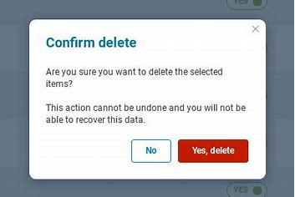
Search
Ishmael Hova
Fault Technician
Keep it cool, get yours today
Faults
Update
Delete
Fault Number : 245
FRIDGE NAME:
Samsung 36-inch wild French refrigerator
FAULT DESCRIPTION:
Water dispenser
ACTION TAKEN:
Inspect the water supply line and connectors for leaks
REPORTED BY: | DATE:
Kim Kardashian | 05 May 2024
REPORTED TO: | DATE:
Ishmael | 05 May 2024
2024 fridge4you Cookie Policy Privacy Policy Careers Promotions

Slide 66
Ishmael
Fault Technician
Keep it cool, get yours today
Welcome
Faults
Dashboard
Once clicked, you will be taken to the DashBoard
Logout
2024 fridge4you Cookie Policy Privacy Policy Careers Promotions

Slide 67
Search
Ishmael
Fault Technician
Keep it cool, get yours today
Dashboard
2024 fridge4you Cookie Policy Privacy Policy Careers Promotions

Slide 68
Ishmael
Fault Technician
Keep it cool, get yours today
Welcome
Faults
Dashboard
Once clicked, you will be taken to the DashBoard
Logout
2024 fridge4you Cookie Policy Privacy Policy Careers Promotions

Slide 69
Subsystem C:
View customer fridges
View Maintenance history
Schedule Visit
Manage Visit
Service fridge
Create Fault

Slide 70
Abraham
Maintenance Technician
Keep it cool, get yours today
Welcome
Customer fridge
Fridge Service
Schedule Visits
Create Fault
Logout
2024 fridge4you Cookie Policy Privacy Policy Careers Promotions

Slide 71
Search
Abraham
Maintenance Technician
Keep it cool, get yours today
Fridges
Search
PDF
Export
Assigned to | Fridge Name | Model | Serial No | Features
Sandisiwe Mahanjana | Samsung 36-inch wild French refrigerator | WRF767SDHZ | 346788RWY767 | Platter pocket Fingerprint Resistant In-door-Ice
Simthandile Njenkele | Hisense 36-inch wild counter depth side-by-side refrigerator | WRS571CIHV | 687899GHY888 | Can Caddy Deli Drawer
Back
2024 fridge4you Cookie Policy Privacy Policy Careers Promotions

Slide 72
Abraham
Maintenance Technician
Keep it cool, get yours today
Welcome
Customer fridge
Fridge Service
Schedule Visits
Create Fault
Logout
2024 fridge4you Cookie Policy Privacy Policy Careers Promotions

Slide 73
Search
Abraham
Maintenance Technician
Keep it cool, get yours today
Maintenance History
Create New Record
Search
PDF
Export
Service Date | Fridge Name | Service Description | Cost | Assigned to | Action
03/03/2024 | Samsung 36-inch wild French refrigerator | Inspect the water supply line and connectors for leaks (water dispenser) | R700 | Sandisiwe Mahanjana | Edit/Remove
06/05/2024 | Hisense 36-inch wild counter depth side-by-side refrigerator | Dust and clean the fans (make noise) | R900 | Simthandile Njenkele | Edit/Remove
Back
2024 fridge4you Cookie Policy Privacy Policy Careers Promotions

Slide 74
Search
Abraham
Maintenance Technician
Keep it cool, get yours today
New Maintenance Record
Fridge Name:
Samsung 36-inch wild French refrigerator
Service Description:
Inspect the water supply line and connectors for leaks
Service Date:
March 2024
27 | 28 | 29 | 30 | 31 | 1 | 2
3 | 4 | 5 | 6 | 7 | 8 | 9
10 | 11 | 12 | 13 | 14 | 15 | 16
17 | 18 | 19 | 20 | 21 | 22 | 23
24 | 25 | 26 | 27 | 28 | 29 | 30
31 | 1 | 2 | 3 | 4 | 5 | 6
Assigned to:
Price:
CREATE
CANCEL
2024 fridge4you Cookie Policy Privacy Policy Careers Promotions

Slide 75
Search
Abraham
Maintenance Technician
Keep it cool, get yours today
New Maintenance Record
Fridge Name:
Samsung 36-inch wild French refrigerator
Service Description:
Inspect the water supply line and connectors for leaks
Service Date:
24/08/2024
Assigned to:
Click to create new service record.
Sandisiwe Mahanjana
Price:
R 700.00
CREATE
CANCEL
service record is created.
2024 fridge4you Cookie Policy Privacy Policy Careers Promotions

Slide 76
Abraham
Maintenance Technician
Keep it cool, get yours today
Welcome
Customer fridge
Fridge Service
Schedule Visits
Create Fault
Logout
2024 fridge4you Cookie Policy Privacy Policy Careers Promotions

Slide 77
Search
Abraham
Maintenance Technician
Keep it cool, get yours today
Schedule Visit
Address:
Assigned to | Visit Date | Time | Address
14 Honeybird 37 Perkins street Nort End
Visit Date:
August 2024
27 | 28 | 29 | 30 | 31 | 1 | 2
3 | 4 | 5 | 6 | 7 | 8 | 9
10 | 11 | 12 | 13 | 14 | 15 | 16
17 | 18 | 19 | 20 | 21 | 22 | 23
24 | 25 | 26 | 27 | 28 | 29 | 30
31 | 1 | 2 | 3 | 4 | 5 | 6
Time:
Assigned to:
Add
Update
Remove
Back
2024 fridge4you Cookie Policy Privacy Policy Careers Promotions

Slide 78
Search
Abraham
Maintenance Technician
Keep it cool, get yours today
Schedule Visit
Address:
14 Honeybird 37 Perkins street Nort End
Assigned to | Visit Date | Time | Address
Assigned to | Visit Date | Time | Address
Sandisiwe Mahanjana | 24/08/2024 | 11:00 | 14 Honeybird 37 Perkins street Nort End
Visit Date:
24/08/2024
Time:
11:00
Click to edit date and time
Click to remove schedule
Assigned to:
Sandisiwe Mahanjana
Remove
Visit has been scheduled.
Add
Update
Back
2024 fridge4you Cookie Policy Privacy Policy Careers Promotions

Slide 79
Abraham
Maintenance Technician
Keep it cool, get yours today
Welcome
Customer fridge
Fridge Service
Schedule Visits
Create Fault
Logout
2024 fridge4you Cookie Policy Privacy Policy Careers Promotions

Slide 80
Search
Abraham
Maintenance Technician
Keep it cool, get yours today
Fridge Fault Report
Fault Number : 245
FRIDGE NAME:
Samsung 36-inch wild French refrigerator
FAULT DESCRIPTION:
Water dispenser
ACTION TAKEN:
Inspect the water supply line and connectors for leaks
REPORTED BY: | DATE:
Sandisiwe Mahanjana | 05 May 2024
REPORTED TO: | DATE:
Abraham | 05 May 2024
Back
Update
Print
2024 fridge4you Cookie Policy Privacy Policy Careers Promotions

Slide 81
Abraham
Maintenance Technician
Keep it cool, get yours today
Welcome
Customer fridge
Fridge Service
Schedule Visits
Create Fault
Logout
2024 fridge4you Cookie Policy Privacy Policy Careers Promotions

Slide 82
Subsystem D:
Manage Suppliers
Process Purchase Request
Create Request for Quotation
Process Quotation
Create Purchase order
Process Delivery Note

Slide 83


Omah Didia
Purchase Manager
Keep it cool, get yours today
Welcome
Suppliers
Purchase Request
Quotations
Purchase Order
Delivery
Logout
2024 fridge4you Cookie Policy Privacy Policy Careers Promotions

Slide 84
Search
Omah Didia
Purchase Manager
Keep it cool, get yours today
Manage Suppliers
Add New Supplier
PDF
Export
Supplier ID | Supplier Name | Contact Person | Email | Phone Number | Address | Payment Terms | Rating
S001 | CoolTech Refrigeration | John Doe | john.doe@cooltech.com | (123) 456-7890 | 123 Cool St, City, State | Net 30 | A
S002 | FridgeWorld | Jane Smith | jane.smith@fridgeworld.com | (987) 654-3210 | 456 Chill Ave, City, State | Net 45 | B
S003 | FreezerPros | Mike Johnson | mike.johnson@freezerpros.com | (555) 123-4567 | 789 Freeze Rd, City, State | Net 60 | A
Back

Slide 85
Omah Didia
Purchase Manager
Keep it cool, get yours today
Welcome
Suppliers
Purchase Request
Quotations
Purchase Order
Delivery
Logout
2024 fridge4you Cookie Policy Privacy Policy Careers Promotions

Slide 86
Search
Omah Didia
Purchase Manager
Keep it cool, get yours today
Request is sent.
Send Purchase Request

Slide 87
Omah Didia
Purchase Manager
Keep it cool, get yours today
Welcome
Suppliers
Purchase Request
Quotations
Purchase Order
Delivery
Logout
2024 fridge4you Cookie Policy Privacy Policy Careers Promotions

Slide 88
Search
Omah Didia
Purchase Manager
Keep it cool, get yours today
Send request

Slide 89
Search
Omah Didia
Purchase Manager
Keep it cool, get yours today
Send Email

Slide 90
Search
Omah Didia
Purchase Manager
Keep it cool, get yours today
Send Email

Slide 91
Search
Omah Didia
Purchase Manager
Keep it cool, get yours today
Send Email

Slide 92
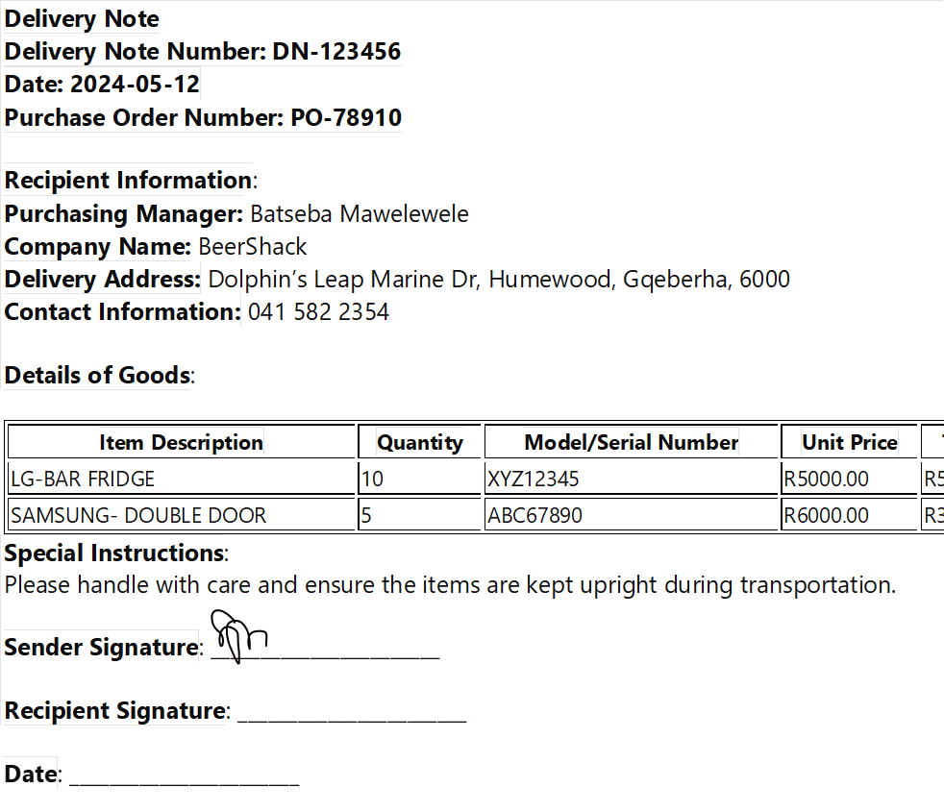
Search
Omah Didia
Purchase Manager
Keep it cool, get yours today
Print Note

Slide 93
Omah Didia
Purchase Manager
Keep it cool, get yours today
Welcome
Suppliers
Purchase Request
Quotations
Purchase Order
Delivery
Logout
2024 fridge4you Cookie Policy Privacy Policy Careers Promotions

Slide 94
THE END.

